Slide 1


micro:bit entry video tutorial
Lesson 1
micro:bit basic lesson 1“Heart beat”
YahBoom micro:bit video tutorial

Slide 2
micro:bit entry video tutorial
Content
Part1
Part 2
Part3
Part 4
Part 5
Learning goals
Preparation
Search for blocks
Combine blocks
Have a try
YahBoom micro:bit video tutorial

Slide 3
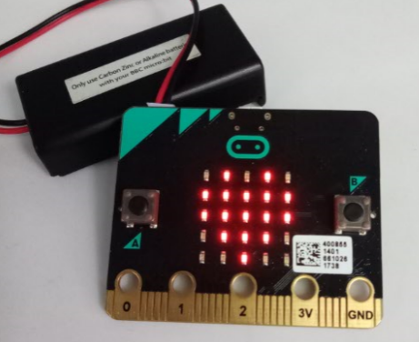
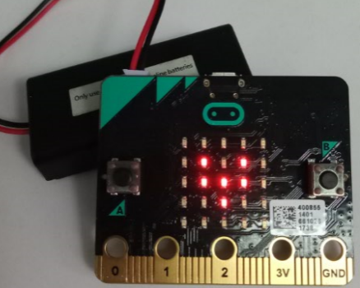
micro:bit entry video tutorial
Part 1
Learning goals
Showing a big heart sharp on LED matrix firstly, and showing small heart later, this cycle looks like heart beat.
YahBoom micro:bit video tutorial

Slide 4
micro:bit entry video tutorial
Part 2
Hardware:
● 1 X Micro: bit Board
● 1 X Micro USB Cable
● 2 X AAA batteries
Preparation
Then the micro:bit is connected to the computer through USB, and the computer will pop up a U disk and click the URL in the U disk to enter the programming interface.
YahBoom micro:bit video tutorial

Slide 5
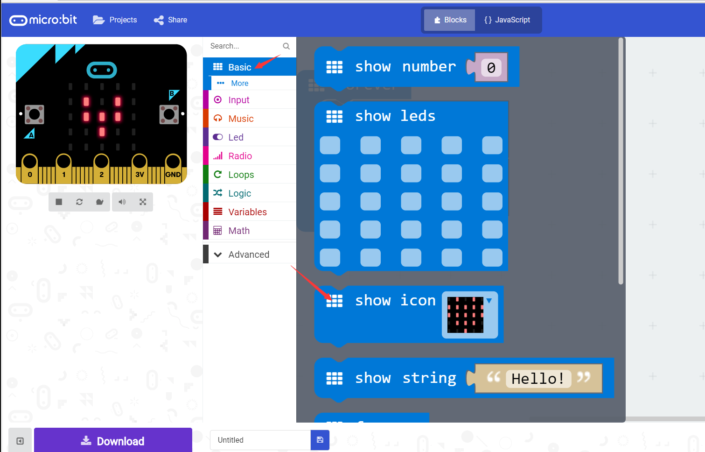
micro:bit entry video tutorial
Part 3
Search for blocks
YahBoom micro:bit video tutorial

Slide 6
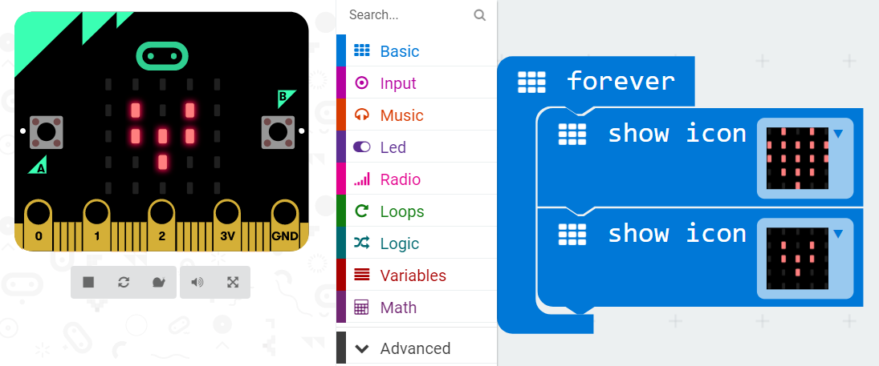
micro:bit entry video tutorial
Part 4
Combine blocks
YahBoom micro:bit video tutorial

Slide 7


micro:bit entry video tutorial
Part 5
Do you learn the course today?
If you learn to do it, give yourself a top quack.
Now give you a homework assignment.
On the micro:bit LED lattice that we just finished the heart beat, we light a circle, a triangle, a rectangle.
Start your little brain. Try it.
Have a try
YahBoom micro:bit video tutorial

Slide 8
micro:bit entry video tutorial
micro:bit
project
Thanks for watching！
Powered by YahBoom
YahBoom Micro:bit video tutorial

